Slide 1
HUMANOID MOVEMENT (Q.P.Q) ENERGY GENERATION
by siddhant , sanjal, amrutha and abbas

Slide 2
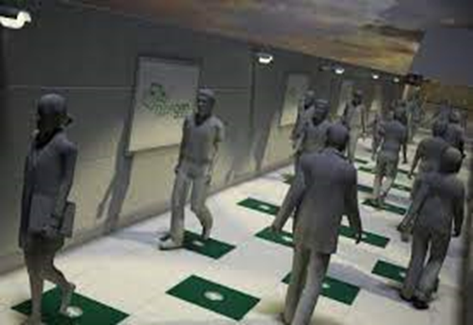
introduction
Man has need and used energy at an increasing rate for his sustenance and well-being ever since he came on the earth a few million years ago.
Due to this a lot of energy resources have been exhausted and wasted.

Slide 3
Proposal for the utilization of waste energy from human locomotion is very much relevant.
It is important for highly populated countries like India where the roads, railway stations, bus stands, temples, etc. are all over crowded and millions of people move around the clock.
This whole human/ bio-energy being wasted if it can be made possible for utilization it will be great invention and crowd energy farms will be very useful energy sources in crowded countries.

Slide 4
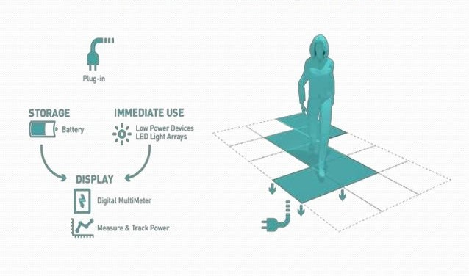
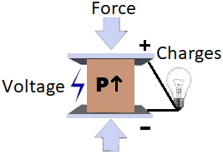
principle
In this project we are generating electrical power as non-conventional method by simply walking or running.
Converting mechanical energy into the electrical energy.
Here the mechanical energy is Stress or Pressure energy.

Slide 5
construction

Slide 6
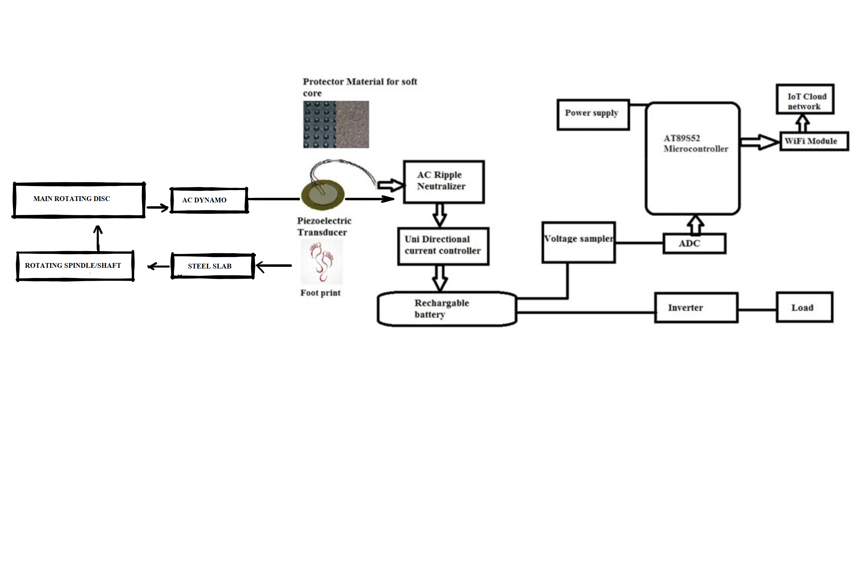
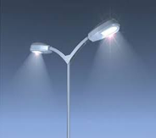
work FLOW DIAGRAM

Slide 7
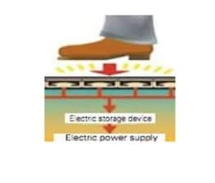
WORKING STEP BY STEP
WALKING ON THE SLAB
First of, walking or running on the slab creates stress energy on the slab which can be assumed as mechanical work.

Slide 8
SPRING AND SPINDLE SYSTEM
Spring system in this project allows the slab to regain its original position so that the generation cycle can be repeated.

Slide 9
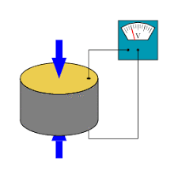
PIEZO – ELECTRIC TRANSDUCER
It is a material that senses the mechanical stress and also has the capability of converting that energy into electrical energy (nearly of 20 watts)
Here the piezo electric is used to sense the force and just add up some voltage to the main generation.
For small scale generation , using the piezo-electric material is just enough to charge anything nearly consuming 20-30 W.

Slide 10
piezo electric
The material that we have used as piezo-electric is quartz .
Quartz crystals offer superior quality and stability
These materials are not very expensive costing around Rs.60-70 for a single piece which makes the overall technology cost-effective.

Slide 11
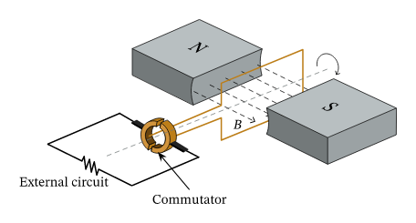
Ac dynamo and generation
The spindle from the spring rotates the shaft that powers the AC Dynamo
which produces an AC current.
The ac current is converted to dc by the application of commutator that is attached to the generator.

Slide 12
INVERTER AND LOAD
Next the electrical energy is stored in a battery with an uninterrupted power supply using an inverter.
The inverter is provided so that even though there is no mechanical work being done at night or anytime , the power supply is continuously made to the load.
This generates energy upto 150-200V which is more than enough to light the street lights.
If we use LED’s to light the load this technology becomes even more efficient.

Slide 14
applications
Footstep power generation system have many applications, but some of them are given below:
The Slab flooring can be done on flat floors, staircase etc.
Mobile Charging
Street Lighting
Bus station lighting
Emergency power failure stations
Colleges.
Schools.
Shopping complex

Slide 15
advantages
Simply walking on the step generates power.
No need fuel input.
This is a Non-conventional system.
Eco-friendly since there is no pollution

